Slide 1
Model Building(7-dars)
Davronbek Malikov

Slide 2
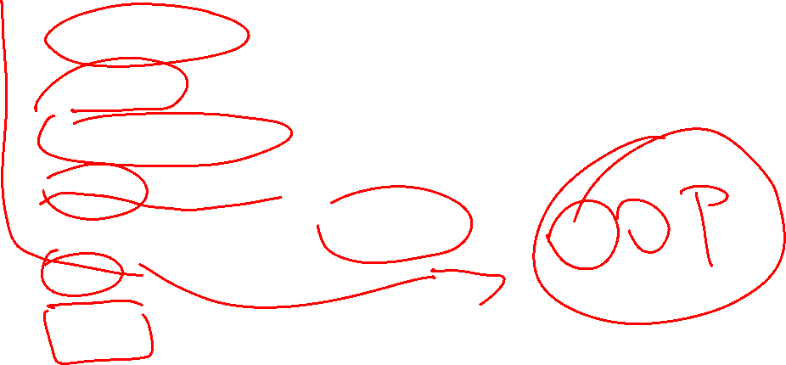
Bugun
Imtixon taxlili
Project 2
Qo’shimcha dars
Feature Engineering
Feature Engineering:Techniques
Class
Vazifa

Slide 3
Imtixon taxlili

Slide 4

Imtixon taxlili
Model Building project
Fold-cross validation
Standard->Creativity

Slide 5

Project 2

Slide 6
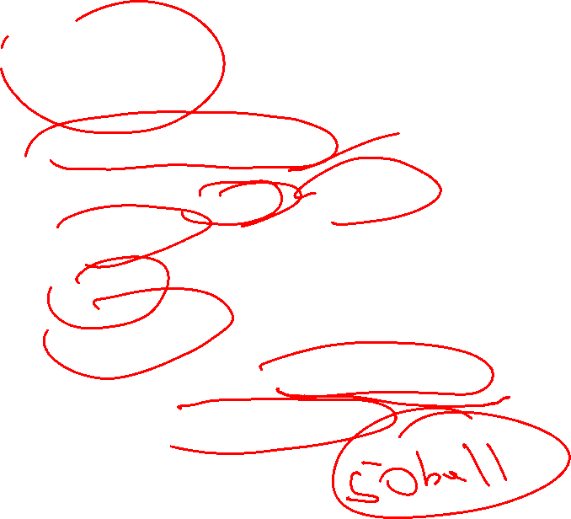
Project 2
Dataset (car2018csv)
Eng yaxshi accuracy/r2/mae
Eng tartibli
Eng to’liq
Eng tushunarli
Topshirish sanasi:12 Sentabr 2025
Himoya: 13 Sentabr 2025

Slide 7
Qo’shimcha dars

Slide 8

Qo’shimcha dars
Keyingi darsgacha idea?

Slide 9

Feature Engineering

Slide 10
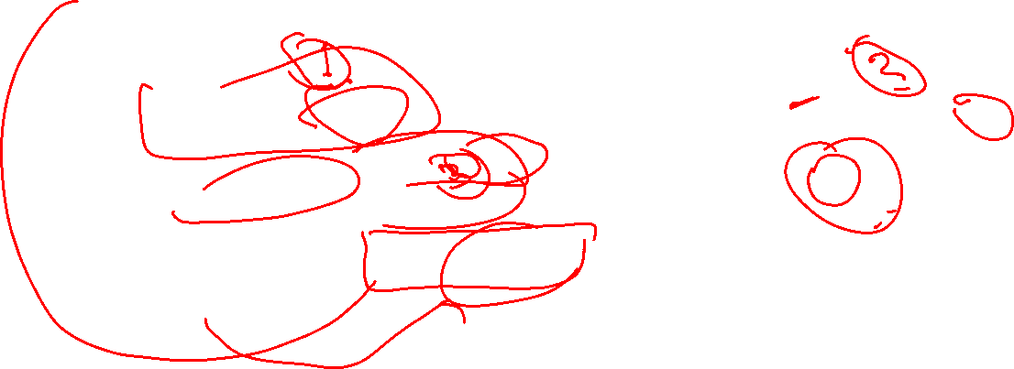
Feature Engineering
Yangi featurelar yaratish, ularni bir turdan ikkinchi turga transform qilish, va muhim featurelarni tanlash bosqichi
Model Performanceni yaxshilash
Yangi featurlar model generalizationni oshiradi

Slide 11
Feature Engineering: Techniques

Slide 12
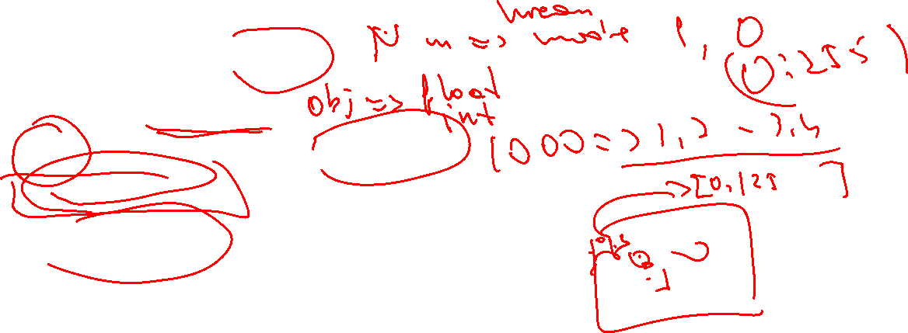
Feature Engineering: Techniques
Handling missing values
Encoding
Scaling(Normalization)->Transforming
Feature Creation
Feature Selection

Slide 13
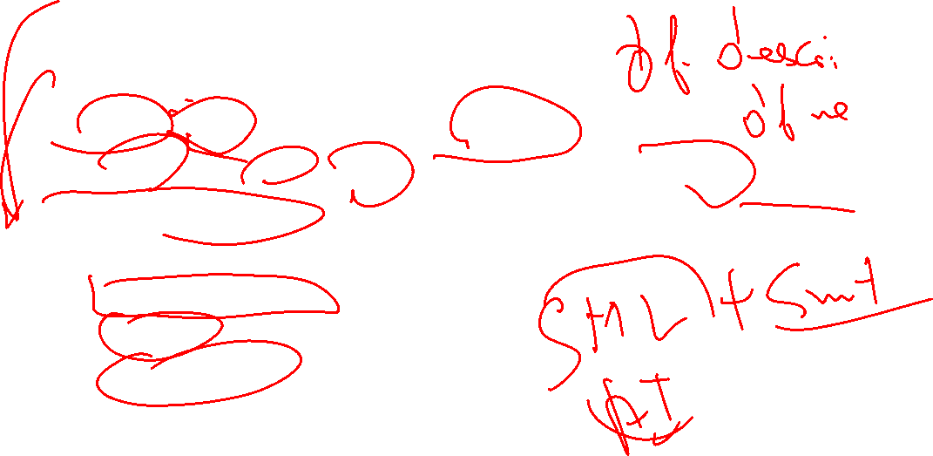

Feature Engineering: Techniques
Feature Creation
Qachon: Raw data yetarli bo’lmaganda
Agar ko’p va foydali data bo’lsa model ketma ketlikni(patterns) ni yaxshi o’rganadi
Nimalar kerak:
Domain knowledge
Creativity
Statistical insight

Slide 14

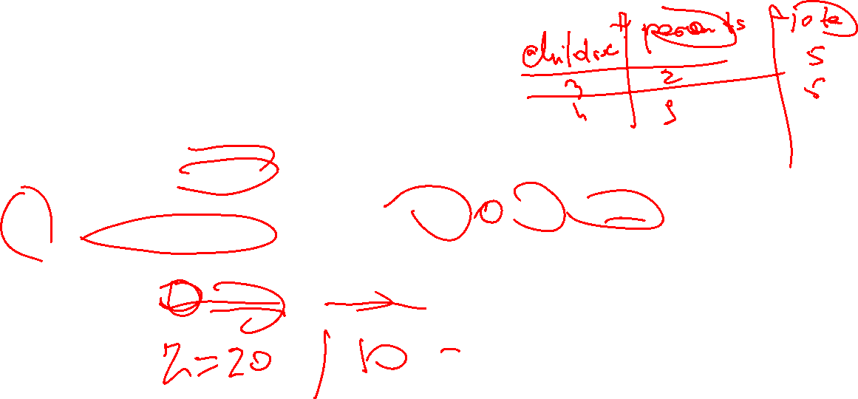
Feature Engineering: Techniques
Nima uchun muhim:
Modeni predictive qobiliyatini oshiradi
Telefon RAMi, rangi ga ko’ra uni modelini yaratish
Modelni o’rganishini osonlashtirish
Koplab featurelarni birlashtirish(farzandlar soni+ ota onalar=family)
Hiddin Realtionships
Butun mavsumdagi gollar soni o’rniga xar bir o’yindagi o’rtacha gollarini sonini taratish(gpg=total_goals/number_games)

Slide 15
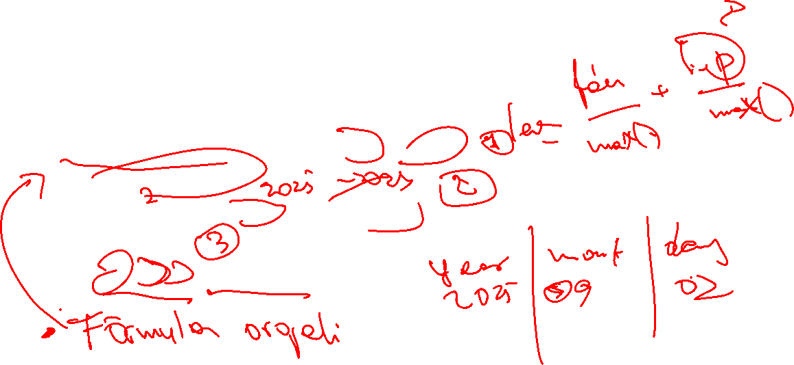
Feature Engineering: Techniques
Qanday bajaramiz:
Matematik yo’l orqali(+,-,/, sum, mean)
Domain knowledge
House age=Current year-Yearbuilt
Time-based
2025.09.02=2025/09/02

Slide 16

Class

Slide 17
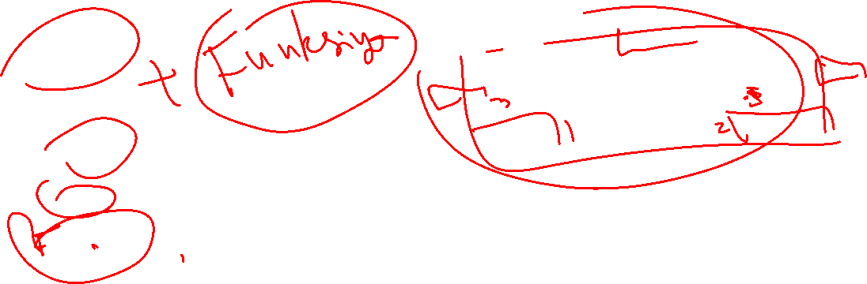
Class
Blueprint/Template==Plan
Object== Real House
F1+f2+f3 = Classes

Slide 18
Vazifa

Slide 19

Vazifa
Githubdan dataset toping
Feature engineeringsiz/engineering orqali o’tilgan barcha algorithmlar bn model yasang
O’zingiz xaqingizda malumot beruvchi class yarating

